Slide 1
EDS PROJECT
Guided By-
Mrs. Prajakta Ugale
Presented By-
1] Vinay Nair (270) PRN: 202101070200
2] Hrishikesh Girsawale (271) PRN: 202201060058
3] Rushikesh Sable (281) PRN: 202201070107

Slide 2
INTRODUCTION:
Data analysis is the process of inspecting, cleansing, transforming, and modeling data with the goal of discovering useful information, informing conclusions, and supporting decision-making. Data analysis has multiple facets and approaches, encompassing diverse techniques under a variety of names, and is used in different business, science, and social science domains. In today's business world, data analysis plays a role in making decisions more scientific and helping businesses operate more effectively.

Slide 3
DETAILS OF DATASET:
Name: T20 Cricket
Number of records (Rows): 1854
Number of records (Columns): 17

Slide 4
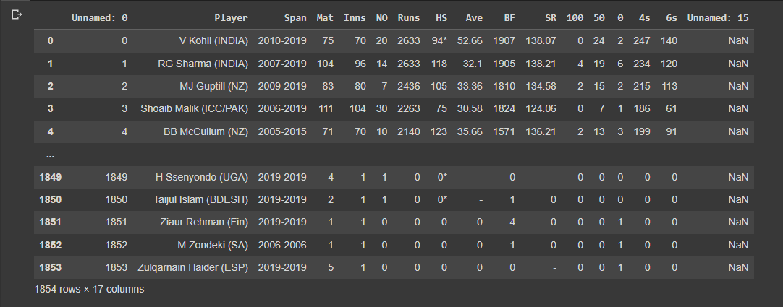

Printing The Data:
Output:

Slide 5
DATA MANIPULATION:
Data manipulation is the process of extracting information and applying logic to it to generate a completely different set of data. In other words, data is modified when manipulated and stored in the same location.
Data manipulation tools aim to change the relationship between data elements and not between the data itself. From the filtering of rows and columns to the classification, regression analysis, and string manipulation, are some of the operations carried out with these tools.

Slide 6
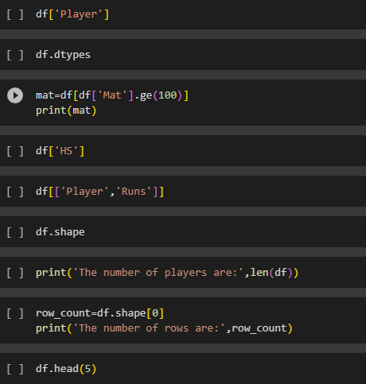
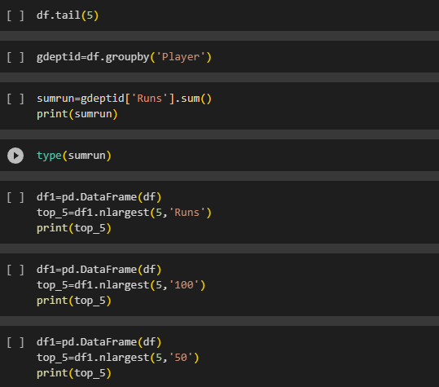
CODE:

Slide 7
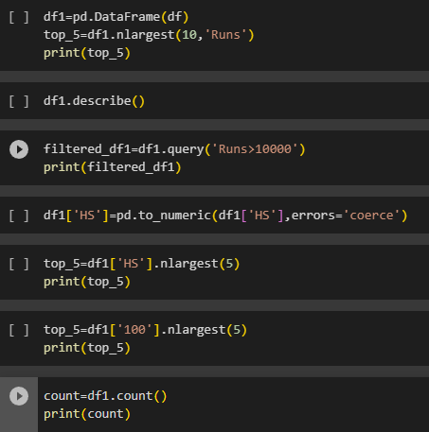
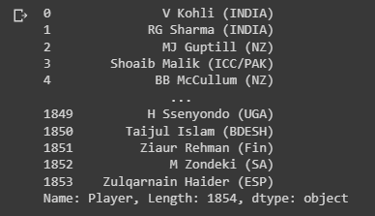
Output:

Slide 8
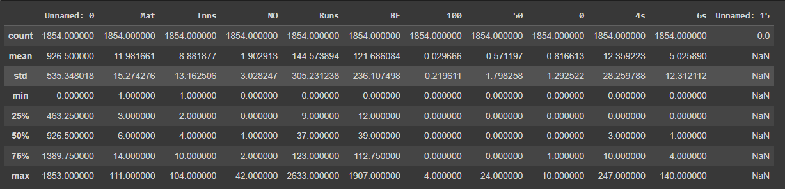
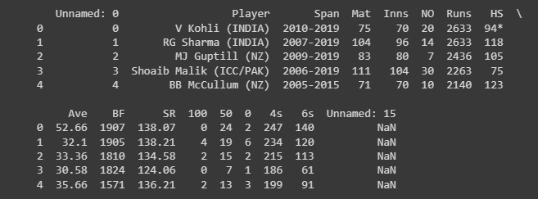

Slide 9
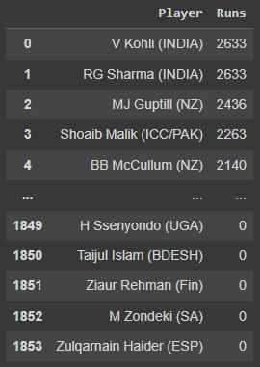
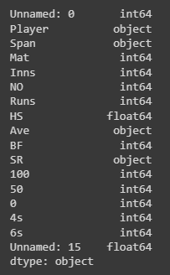

Slide 10
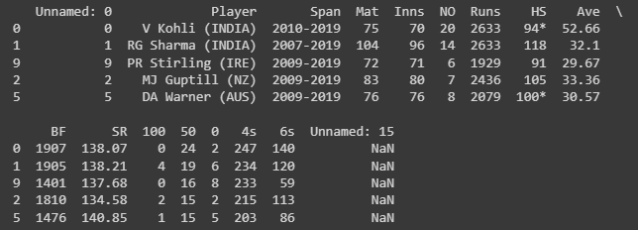
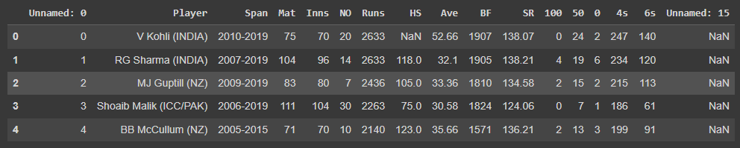

Slide 11
DATA VISUALISATION:
Data visualization is the representation of data through use of common graphics, such as charts, plots, infographics, and even animations. These visual displays of information communicate complex data relationships and data-driven insights in a way that is easy to understand.

Slide 12
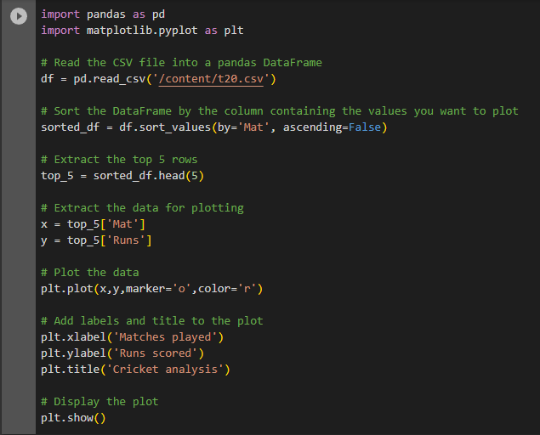
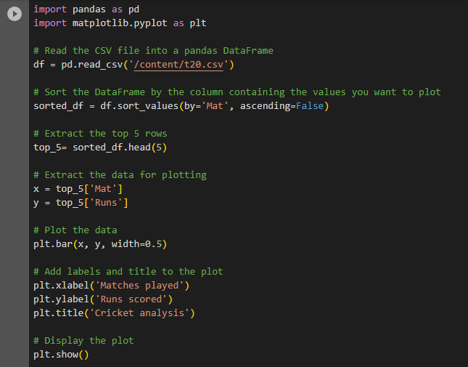
CODE:

Slide 13
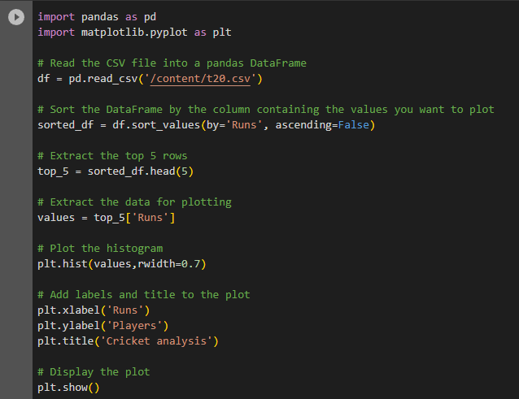
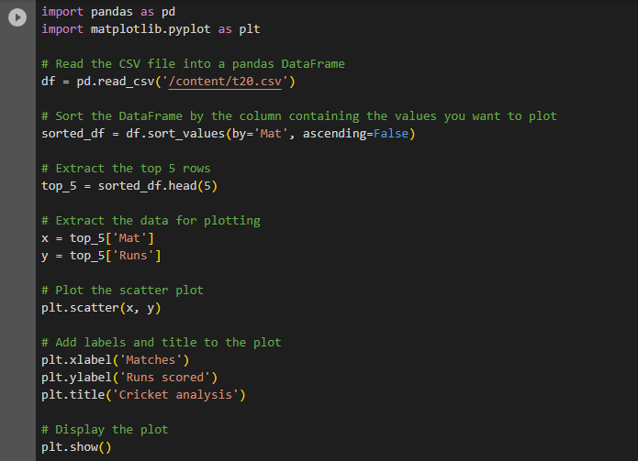

Slide 14
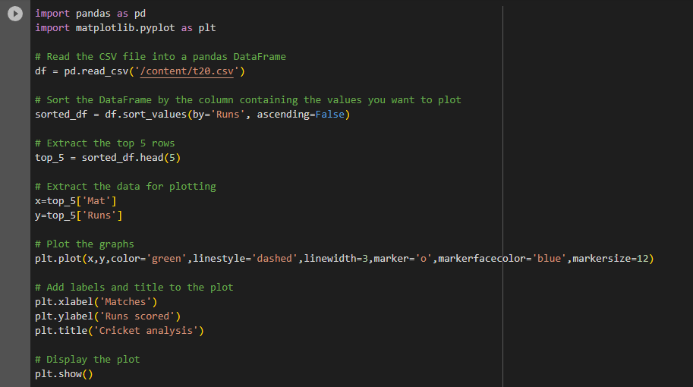

Slide 15
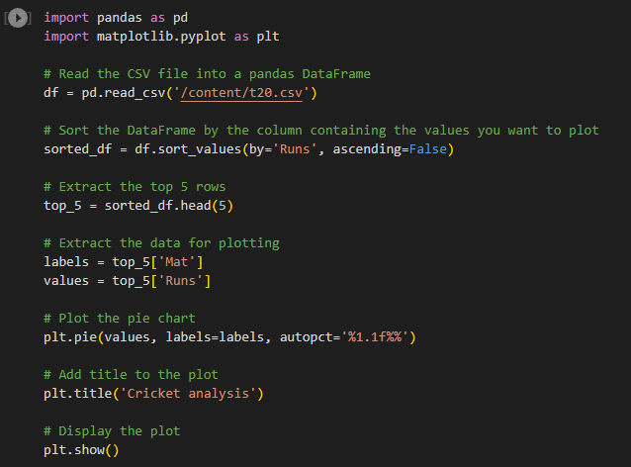
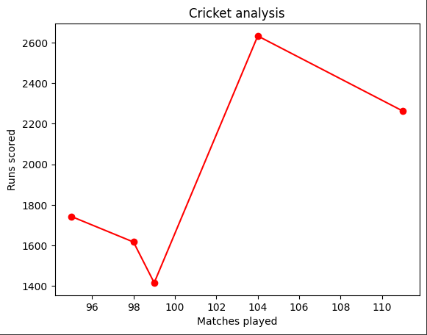
Output:

Slide 16
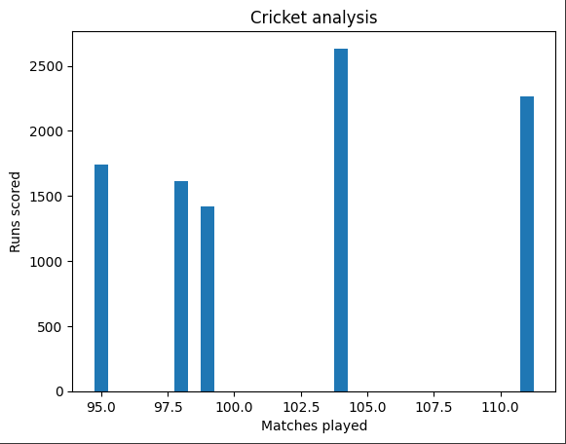
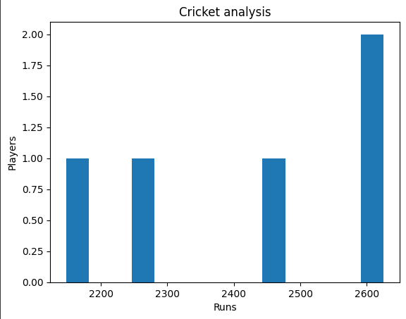

Slide 17
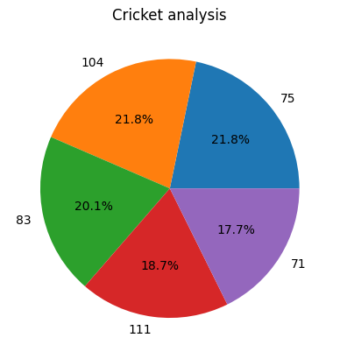
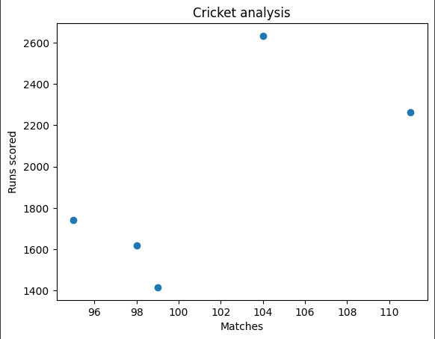

Slide 18
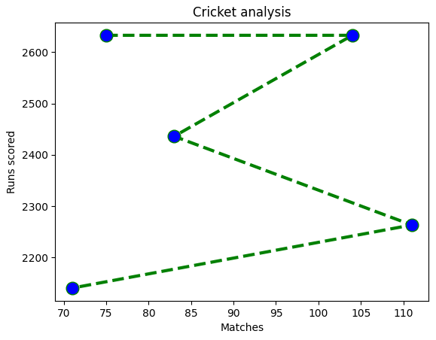

Slide 19
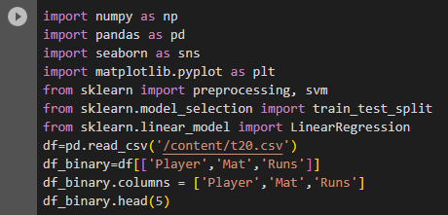
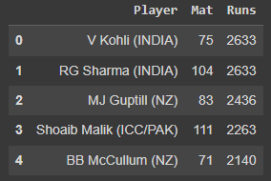
REGRESSION:

Slide 20

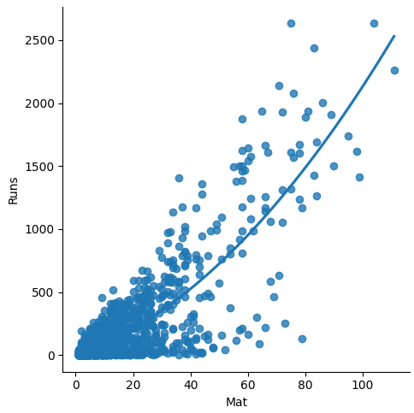

Slide 21



